Slide 1

LoRaWAN Tracking System
Darryl Bilongo, Louis Boucquet, Melvin Campos Casares, Constantin Mirica April 26th, 2019
Group 7
Wild animals tracking - An IoT Solution

Slide 2
Plan
Introduction
?
Technical part
How it works
Web dashboard
Conclusion

Slide 3
Introduction
A solution to help the Faune & Biotopes Association to:
Manage their tracking of wild animals using IoT devices,
Help wildlife and habitats in a multifunctional and integrated perspective,
Have a better knowledge of the faune and its habitats,
Have a good management of the faune and its habitats,
Have a better approach for the conservation of the nature.

Slide 4
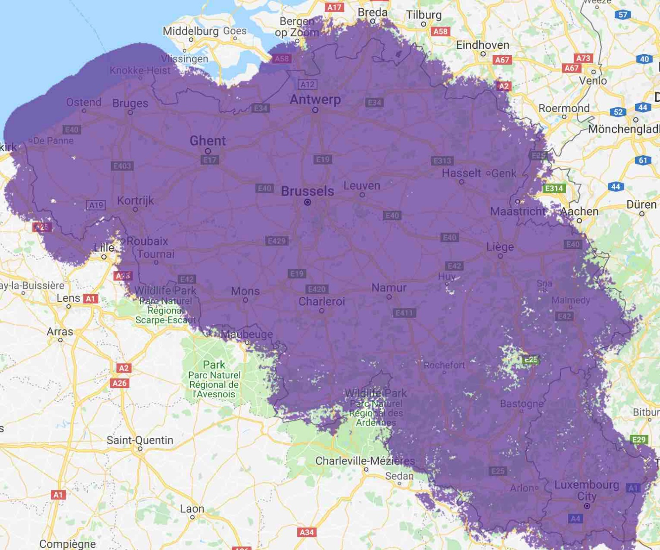
?
Ideal for long range and low power IoT networks
has nearly a complete outdoor network coverage

Slide 5
Technical part
LoRaWAN Rapid Development Kit
Sodaq Mbili card Rev6 (Arduino based)
LoRa network connection chip (developed by Microchip)
Antenna
Battery
Sensors
Grove – GPS
Grove – 3-axis Digital Accelerometer (+/- 1.5g)
Proximus Enco account

Slide 6
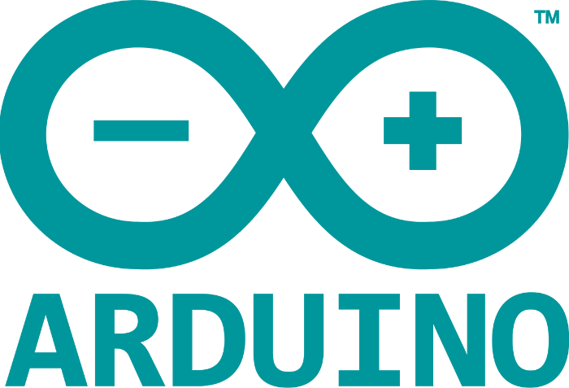


How it works
Take GPS data :
Every hour
When movement
Put GPS data in a file
Send it every hour
Receive data from Arduino
Send data to server
Collect data
Show it on the website
Use of Open Street Maps

Slide 7
Web dashboard
ephec.herokuapp.com

Slide 8

Conclusion
Ease of use and works with any LoRa network available worldwide by simply changing the key.
Further implementation?
Integration of « Grove – light Sensor v1.2 »
In order to know if the animal is underground and/or if it’s night.
Save an array of GPS coordinates
Send more information about where the animal went,
Better accuracy on the website.
Create a smartphone webapp

Slide 9
Questions ?
Questions ?
Questions ?
Questions ?
Questions ?

